Slide 1
BM7703
Cross-cultural Issues in international business
SESSION 4
Communicating across cultures Part 2
Sara hooke

Slide 2
Communicating across cultures Part 2
This week we are going to…
Examine academic research evidence and findings on cross-cultural communication. This session aims to enhance your understanding of how to communicate effectively in diverse and changing business contexts, with internal and external stakeholders.

Slide 3
Why are we looking at this?
It links to our learning outcomes…
…As it displays flexibility in evaluating own behaviour and communication style from others’ perspectives and adapting these to a range of complex, multicultural and multilingual contexts

Slide 4
Why are we looking at this?
It links to your assessment
…your manager at GlosTech (who is from the UK) asks for your help in understanding the issues that may arise for a project group that they have put together …
1.What issues might the team experience whilst they work on this project? Think particularly about communication, decision making and trust.
https://moodle.glos.ac.uk/course/view.php?id=60048

Slide 5
SESSION AGENDA
The power of language and the pitfalls of Verbal Communication
Language in High/Low Context societies
Language barriers/pitfalls in communication
Intercultural Business Communication

Slide 6
Recap: DEFINITIONS OF COMMUNICATION
From a historical point of view the word ’communication’ is based on the root ‘common’ which reflects the aim as ‘ sharing knowledge’ or ‘common sense’. (Rosengren, 2000)
Communication is a complex process involving numerous situational and contextualization factors that determine the availability and importance of specific cues. (Bryant, Marmot and Ramirez, 2011)
Notes:
Communication starts in this definition in a very simple format
BUT we then move on to understand that it is a process, a COMPLEX process involving specific cues and an understanding- a mutual understanding of those specific cues. And importantly this definition notes that there are contextual factors involved- factors that are specific to the context of the communication-
Does this remind you of anything from previous weeks? Erin Meyer- Communicating Scale High/low context societies

Slide 7
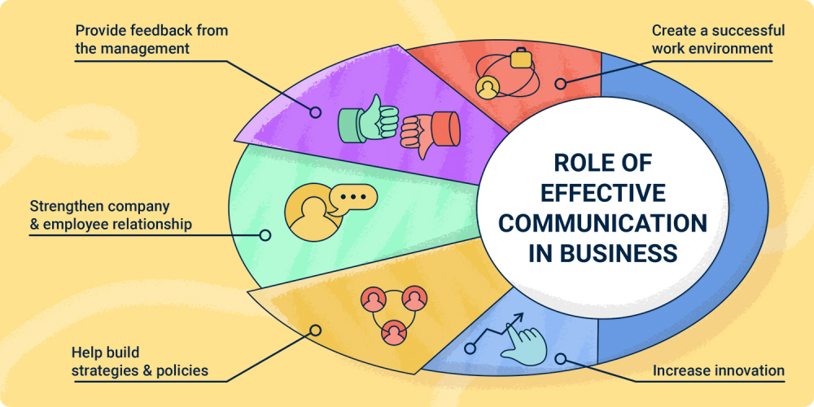
IMPORTANCE OF COMMUNICATION IN BUSINESS
Communication is a critical factor in cross-cultural management in relation to Motivation, Leadership, Group Interactions and Negotiations
Culture is conveyed and perpetuated through communication. They are intertwined and through communication:
-Relationships are built
-Conflicts resolved
-Innovative ideas created and shared
(Deresky, 2017)

Slide 8
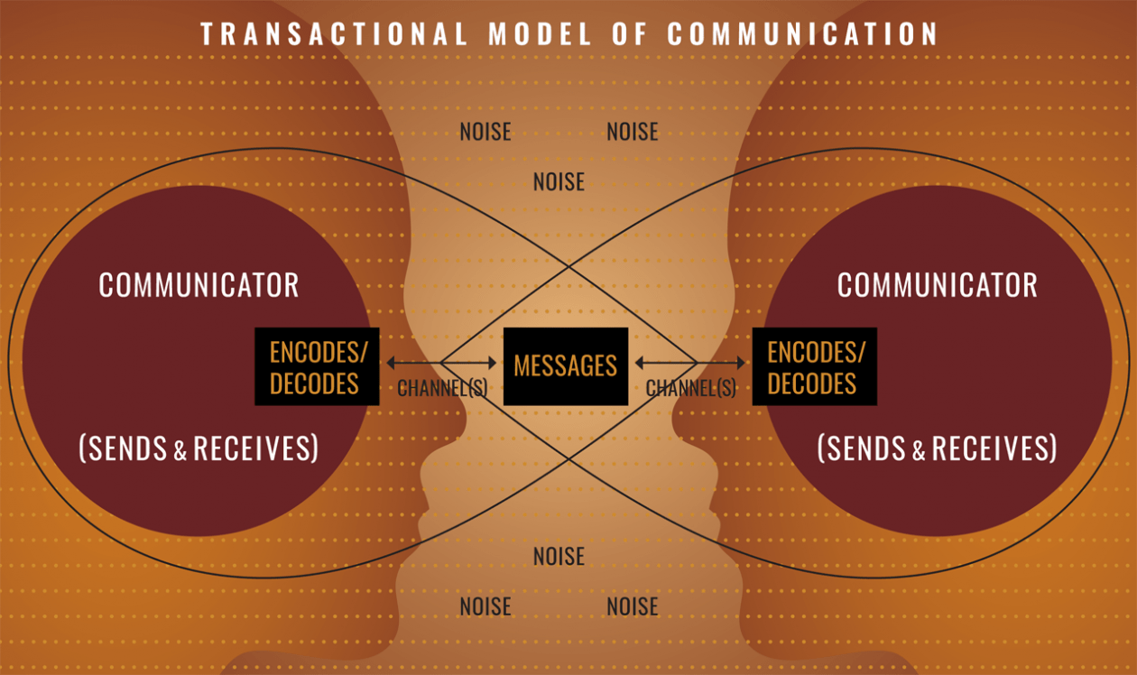
Notes:
https://www.natcom.org/about-nca/what-communication
Communication focuses on how people use messages to generate meanings within and across various contexts
This illustration shows the transactional model of communication
Communication cuts across contexts and situations; it is the relational and collaborative force that strategically constructs the social world. Knowledge and understanding of communication and strong communication skills allow people to create and maintain interpersonal relationships; employers in all sectors seek employees with strong communication skills; and society needs effective communicators to support productive civic activity in communities.
What could the noise be in a global business environment?
Culture!
Deresky points out that the more dissimilar cultures are the bigger the chance of noise

Slide 9
Recap: DEFINITIONS OF COMMUNICATION
Communication is a process of creating and sharing meaning by transmitting messages via media such as words, behaviour or material artefacts. (Johnson, 2021).
Anything that undermines the communication of intended meaning is referred to as noise. The more dissimilar the culture, the bigger likelihood of noise. (Deresky, 2017)
Notes:
So communication is a process- its complex, there are a lot of different factors that are going to come into it for the message that is being sent. To be the same message that is received.

Slide 10
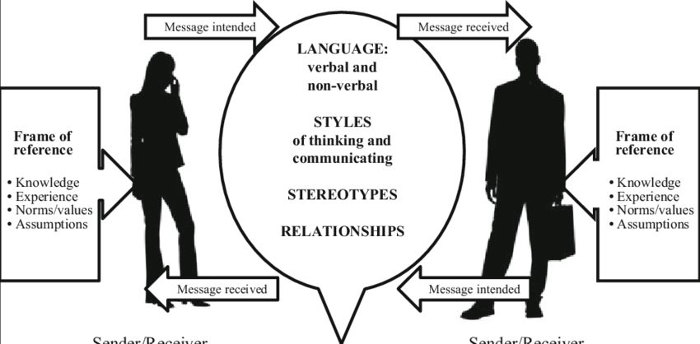
MODEL OF CROSS CULTURAL COMMUNICATION
Based on (Browaeys 2015).
Notes:
Browaeys, (2015). Understanding cross-cultural management 3rd edn pdf ebook. Pearson Education, Limited.
Communication filters in the middle.
So when we talk about cross cultural communication as can be seen in this diagram, the model becomes much more complex.
Links to
Communication is a complex process involving numerous situational and contextualization factors that determine the availability and importance of specific cues. (Bryant, Marmot and Ramirez, 2011)
A message is sent and received but how it is interpreted (coded and decoded) depends on the frame of references- our culture.
If they are from 2 very different culture the noise may be too great to be able to understand each other. They might not understand for example if the message is urgent or not?
If we think about this through Hofstede, Schwartz, Trompenaars, Meyer, we can start to think about Power distance, low/high context cultures, attitudes towards time can all impact on communication.
Speaking different languages or first languages can be a barrier. What if they use the wrong words? Looking at language we also need to consider that non verbal language can be considered noise
How can non verbal communication be noise?
Anything that undermines the communication of intended meaning is referred to as noise. The more dissimilar the culture, the bigger likelihood of noise. (Deresky, 2017)

Slide 11
CULTURAL VARIABLES IN THE BUSINESS COMMUNICATION PROCESS
According to Victor (1992) business communication is affected by people’s perceptions dependent on these cultural variables:
-attitude
-social organization
-context
-authority(roles we play)
-non verbal communication
-time
-space
-language (spoken and written)
Notes:
So people’s perceptions affect business communication and these are affected by cultural variables.
We looked at most of these variables last week.
This week we will conclude with language.

Slide 12

Lingua Franca
Notes:
What is a Lingua Franca?
A bridging language. A language used for communication between people who speak different native languages
Business English is a Lingua Franca but there can be others

Slide 13
SOURCES OF TROUBLE IN BUSINESS ENGLISH AS A LINGUA FRANCA
Language skills - (English words and grammar)
Interpersonal Communication skills - (perceptions and culture)
Diversity of Globalised Business Community – (conceptualizing roles and context through the lenses of different corporate cultures)
Accents
BEWARE OF:
Harsh Language
Vague Language
Misleading Interpretation
Technical Language
Use of Jargon

Slide 14
Accents…
https://www.facebook.com/reel/843538154120517

Slide 15
LANGUAGE IN BUSINESS ENCOUNTERS
How do you communicate with someone who is from a different country? In your language, their language, or a third language? - ‘International English’
When using interpreters consider availability, cost and reliability.
The role of non verbal communication will be reduced and extra meaning may be lost in the translation. The development of relationship and trust building can be hindered by the intermediaries.
A more practical solution is to use ‘expat’ managers if available.
Beware of shared language nuances and word meaning differences like between US and UK as well as dialects used like Indian English, Singapore English and South African English.

Slide 16
DIFFERENT MEANING
US UK
Smart—intelligent, sharp looking, well groomed
School – elementary level
Ship – convey by boat only
Bomb – explosive device,
overwhelming success.
Smart — intelligent
School- any level educational institution
Ship – to convey by boat, train, plane, truck
Bomb- explosive device; overwhelming failure

Slide 17
SPOKEN LANGUAGE IN HIGH AND LOW CONTEXT CULTURES
Low context cultures prefer messages with clear meaning with nothing hidden behind it. Silence is uncomfortable and you are expected to be good at expressing yourself. (USA, UK, etc.)
High context cultures are more indirect and subtle. There is implicit meaning behind messages. You are expected to listen more.
Silence has a place in the conversation. It carries meaning! (China, Japan, etc.)

Slide 18
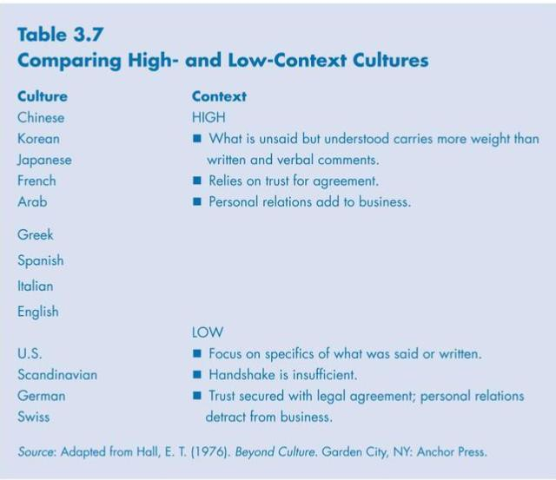

Slide 19
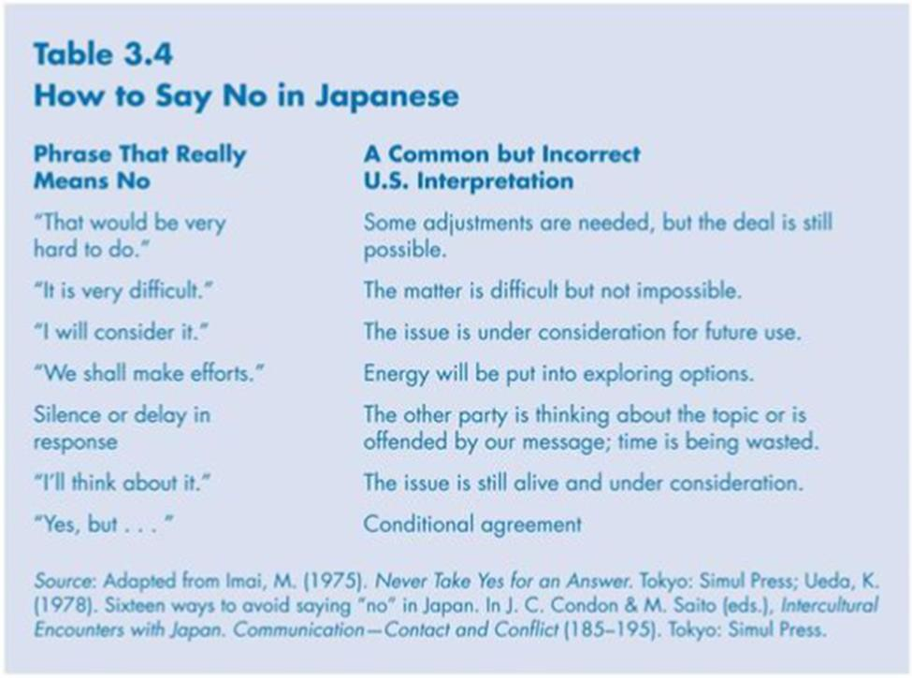
HIGH/LOW CONTEXT CULTURES COMPARISON

Slide 20
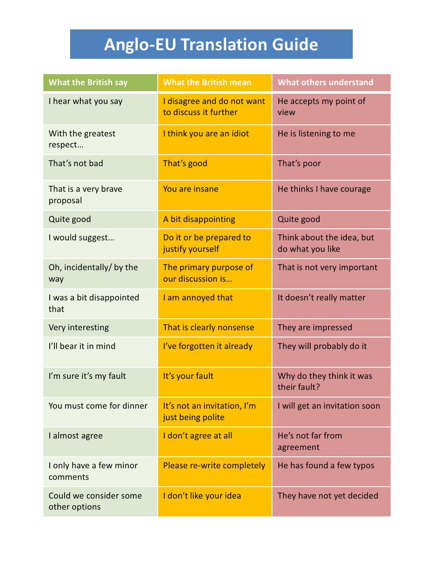

Slide 21
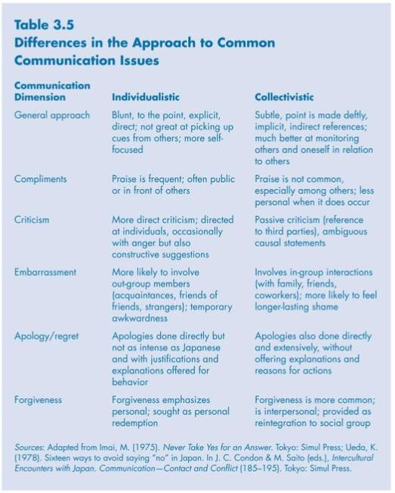
Notes:
Japan collectivist
US individualist

Slide 22
COMMUNICATION AND COLLABORATION
Effective collaboration is built by effective communication.
Academic studies have traced the failure of some Multi-national business ventures to three significant factors:
the lack of intercultural skills and competence,
the inability to communicate effectively in a global setting,
the failure to apply appropriate etiquette in business negotiations.
Notes:
Effective collaboration is built by effective communication. In international alliances success depends a lot on the existence of trust between the parties. Building trust in different cultures is done differently. In USA business is based on formal contracts while in China and Japan on long standing relationships build on trust.

Slide 23
Is miscommunication most likely between:
A) A Low Context Culture and another Low Context Culture
B) A Low Context Culture and a High Context Culture
C) A High Context Culture and another High Context Culture

Slide 24
THE ROLE OF LANGUAGE IN GLOBAL BUSINESS
Research conducted on Mergers and Alliances has shown:
In MNCs informal oral communication prevails
Language = power in organisations
Language affects perceptions of oneself and others
Language unites but can also divide people and organisations
Business English as Lingua Franca (BELF) is not a ‘cultureless language’
(Charles, 2007)
Notes:
Mäkelä, Kalla, and Piekkari (2006),, look at language as both a uniting and a dividing feature at organizational level. They discovered a “clustering” phenomenon in MNCs. According to them, units in countries with close linguistic and cultural affinity tend to communicate, cooperate, and share knowledge with each other, but fail to do so with units whose linguistic and cultural characteristics would require greater linguistic and cultural effort. Marschan (1996) referred to as “shadow structure,” with corporate employees communicating with those with whom they can easily communicate (because of language and culture) rather than with those with whom they should, according to their professional and business interests, be communicating. By dividing individuals into “us” and “them”—those who “can” and those who “cannot”—language can be seen as having the same divisive impact at group level. This is obviously a challenge for multinationals, particularly in view of the fact that language effects—both positive and negative—are not always overt and obvious, and language as a potential factor in corporate success or failure is frequently overlooked.
Difference between ELF an BELF
90% of English speakers are non-native speakers
BELF is focused on getting the job done
This ability of BELF speakers to understand each other must surely be partly attributable to their shared business background (in spite of great diversity), and shared purpose, with the help of which discoursal interpretations are made
Problems were created by NS communication as well as by NNS; it seems that NSs’ sophisticated language could be difficult for NNSs to comprehend.
LANGUAGE MATTERS IN GLOBAL COMMUNICATION. Charles, M. 2006

Slide 25
LANGUAGE & RELATIONSHIPS
The cost of language barriers is damaged relationships and erosion of trust in MNCs
The command of language is a base for ‘clustering’ merely on cultural similarity and language grounds to the detriment of the task at hand. Groups are formed and an attitude of ‘us’ and ‘them’ can be established, which hinders ideas sharing and rapport
Language difficulties hinder socialization, bridging differences and bonding in teams. Building personal relationships in teams is a key to sharing insights, open and honest communication and the building of trust.
Note: Technical language competence is not enough to guarantee relationship development. Empathy and interpersonal skills are also required.
(Cohen and Cassis–Henderson, 2012)

Slide 26
COMMUNICATION CHANNEL & CULTURE
Culture influences the chosen mode of communication – F2F; email, phone call, videocall(Zoom, Teams, Skype, etc.)
US- cold calls are acceptable and CONSIDERED a normal business practice
Japan- cold calls are ‘unthinkable’-not practical for winning business.
In individualistic societies – speed and efficiency are valued higher than trust and as a result written communication suffice.
In collectivistic societies oral communication is initially preferred to establish trust between the parties before written communication is introduced.
Communication channel depends on the context, on the available technology and on the culture of the sender/receiver of messages.

Slide 27
COMPUTER MEDIATED COMMUNICATION
Lets consider the ubiquitous email - Should it be formal or informal. Is it a letter or a memo or a more conversational form of communication? Should it be explicit? Is language accuracy important?
DISADVANTAGES:
Electronic mail lacks the non verbal cues like body language , face expression and other non verbal behaviour. It carries the pitfalls of inaccurate language, poorly structured text, and wrong writing style. However in theory communicating parties can eradicate mistakes because they have time to reflect and discuss the process in following exchanges.
Apart from culture research has shown that gender plays a role in electronic communication. Women and men structuring messages differently and women value politeness more.

Slide 28


CAUSES OF COMMUNICATION PROBLEMS
A study of international companies in Poland has shown that the underlying causes of communication problems could be based on:
Lack of active listening
Misinterpretations of somebody’s words
Cultural differences (different attitude toward the work culture, different priorities)
Focusing only on one’s own interpretation of the message sent
Stereotypical way of thinking
KIC-DRGAS (2015)
15

Slide 29
CAUSES OF COMMUNICATION PROBLEMS
Emotional blocks
Hostile attitude towards the speaker
Analysing the communication via the outcome of past events
Lacking knowledge
Lacking willingness to find meaning in discussion
KIC-DRGAS (2015)

Slide 30
The Role of Silence in Verbal Communication
Dependent on culture what is said is not always what is meant. Silence also has different meaning in different cultures.
For example in Japan people will often reply with ‘yes’ as a sign of respect and acknowledgement that they have heard the message rather than that they agree.
Developing effective verbal communication depends also on trust. Building trust will help cultural misunderstandings to be considered less rude and more acceptable.

Slide 31
GUIDELINES FOR BUILDING TRUST GLOBALLY
Create clear and calculated basis for mutual benefit
Establish realistic commitments and good intentions to honour them
Improve predictability
Strive to resolve conflicts and keep communication open
Develop mutual bonding through regular socialising and friendly contact
(Deresky, 2017)

Slide 32
INTERCULTURAL BUSINESS COMMUNICATION (IBC)
What is it?- the communication among individuals or groups from different cultural backgrounds in a business environment. It will deal with intercultural issues in business and may require specific knowledge about culture, communication and business.
IBC is not a static fabric or comparison between cultures (Ladmiral and Lapiansky, 1989) but an interactive phenomena that is systemic but is also dynamic and is subject to changes brought by the interactions. (Browaeys, 2015)
When business people from different cultures interact, they bring their own backgrounds with them to create ‘transactional culture’. They also step out of their own cultural and business environment and create a new context.
(Varner, 2000)
Notes:
Not just IB and communication
Three variables
Culture communication and business
Complex!
Links to Charles’ (2007) work on BELF Business English as Lingua Franca

Slide 33
INTERCULTURAL BUSINESS COMMUNICATION IS A DYNAMIC PROCESS
In intercultural business communication, the business strategies, goals, objectives, and practices become an integral part of the communication process and help create a new environment out of the synergy of culture, communication, and business.
Business people need to take into account the national culture, the general business culture, and the specific corporate culture. In addition, they must be aware of individual communication styles.
Managers will be more successful if they have an understanding of each other's cultural and business backgrounds.
Varner (2000)
Notes:
Business people need to take into account the national culture, the general business culture, and the specific corporate culture. In addition, they must be aware of individual communication styles.
The intercultural business communication research draws heavily
from intercultural communication and international business (Lovitt,
1999). However, relying on research from related disciplines can create
risks. For example, imported research may provide answers to questions
that do not go to the heart of intercultural business communication and
impose its own conceptual model of intercultural communication or international
husiness that may hinder the development of more appropriate
concepts of intercultural husiness communication (Lovitt, 1999).
When two business people from two different cultures interact, they
bring their own backgrounds with them, but they also step outside their
own cultural and business environment and create a new context (Bolten,
1999). Bell (1992) calls this new context "transactional culture" (p. 452).
The difference between intercultural communication and intercultural
business communication is not just that the latter takes place in a business.
In intercultural business communication the business strategies,
goals, objectives, and practices become an integral part of the communication
process and help create a new environment out of the synergy of
culture, communication, and business.

Slide 34
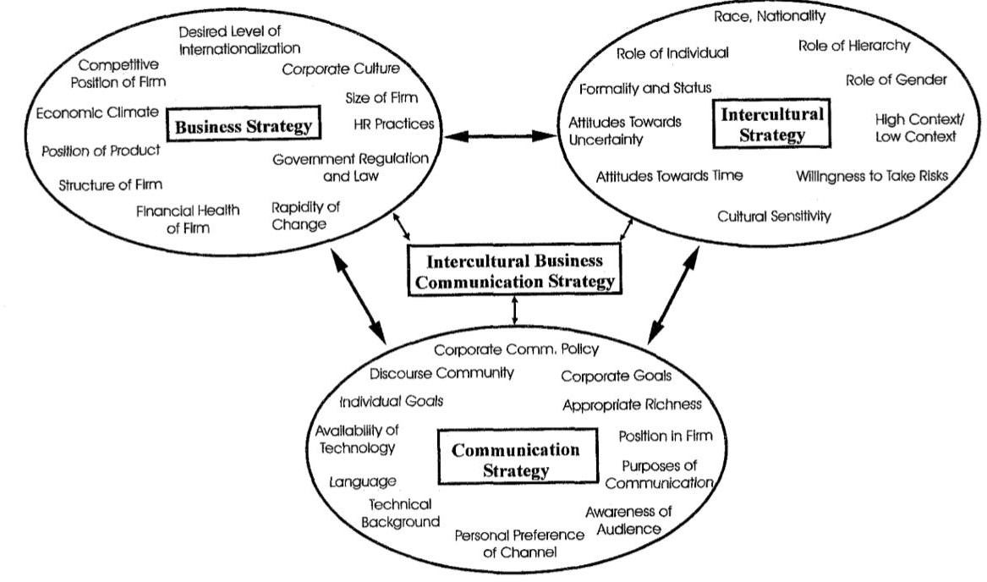
INTERCULTURAL BUSINESS COMMUNICATION MODEL
Varner (2000), p.4

Slide 35
INTERCULTURAL BUSINESS COMMUNICATION
People who communicate successfully in an intercultural business environment are able to recognise their own self-reference criterion - the tendency to evaluate everything on one's own cultural background - and are willing to adjust their views in light of new evidence.
Strong corporate culture of MNCs may negate some of the traditional cultural characteristics of a subsidiary country.
For example, an Indian employee of Procter & Gamble may have completely accepted a corporate culture of timeliness and punctuality that, at least in the work setting, is replacing the traditional polychronic time orientation of Indian culture.
When a company goes from an export stage to a foreign subsidiary stage, the need for
both cultural awareness and international business knowledge changes.
Varner (2000)
Notes:
Do you know what ethnocentric attitudes/culture means?
This is where the ‘home’ culture of the MNC, their corporate and managerial culture, is imposed in the parts of the organisation in ‘host’ countries. This can create a lot of noise!
What is the danger of doing this?
They may become disgruntled, demotivated, may stop sharing information, may feel insulted or disrespected.
To avoid this you could practice geocentric or polycentric culture
Polycentric where MNC recognises the different culture in every host country, employees people with own culture, management, style of communication. Respects the culture and does not impose.
In geocentric, the organisation understands about different cultures an attempts to build an international corporate culture. Picks bits form different cultures to create a best practise corporate culture. Eg Coca-cola and also google

Slide 36
INTERCULTURAL BUSINESS COMMUNICATION STRATEGY
Many cultures have their own different cognitive frames which determine what is considered logical and rational in their cultures. Hence, people think differently, approach business problems differently, and communicate differently.
The channels, levels of formality, use of technology, content and style of delivery
are influenced by cultural and business considerations.
The objectives of the business, the level of internationalization, the structure of the organization will help determine the intercultural business communication strategy.
A communication strategy that does not take the specific business context into consideration will not be effective.
Varner (2000)

Slide 37
DRIVING FORCES OF INTERCULTURAL COMMUNICATION
Globalisation
Continuous organisational change
Communication technology
Language is a driving force of Globalisation together with technology. Language is an Enabler!
Research shows that more business is done between non-native speakers of English than between native speakers of English.
Research also shows that Verbal Communication plays a primordial role in intercultural communication

Slide 38
Summary of communication across cultures Part 2.
The role of language in global business
English as Lingua France (ELF & BELF)
Intercultural Business Communication strategy

Slide 39
Seminar questions
Why should companies adopt a common corporate language?
Why English? Why not Mandarin?
What can go wrong when companies introduce a single corporate language?
What should companies do in order to get buy-in from employees
What should native/proficient speakers do to help?
Have a look at the HBR article: Global Business Speaks English.

Slide 40
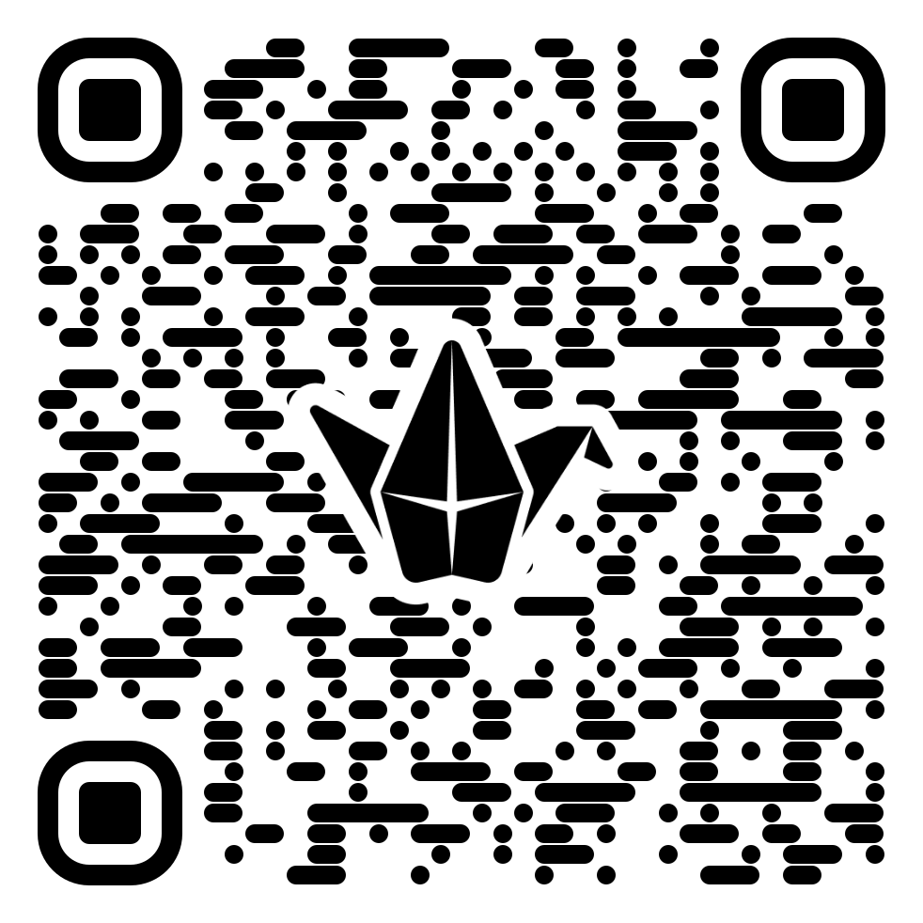
Seminar activity 2.
Using the country cultures we have chosen for the assignment
Think about the communication issues the group may experience
What could happen when there is a disagreement, or negative feedback needs to be given shared?
Link to Padlet

Slide 41

QUESTIONS ABOUT ASSESSMENT
If you have any questions about Assessments. You can post them at the link below and the MT can respond to them.
Link

